Slide 1
Stable Blockchain Sharding under Adversarial Transaction Generation
Ramesh Adhikari, Costas Busch, Dariusz R. Kowalski
School of Computer and Cyber Sciences
Augusta University
Augusta, GA, USA
SPAA 2024
Nantes, France
June 20, 2024
Notes:
Hello everyone, good afternoon. My name is Ramesh Adhikari, and I am a PhD student at Augusta University.
Today, I will be presenting our paper titled "Stable Blockchain Sharding under Adversarial Transaction Generation.”
This is a joint work with my PhD advisor, Dr. Costas Busch, and Dr. Dariusz R. Kowalski.

Slide 2
Overview
Research Purpose
Background
Related Works
Our Proposed Models
Simulation Results
Conclusion and Future Work
Notes:
In this talk, I will cover the following topics:

Slide 3
Research Purpose

Slide 4
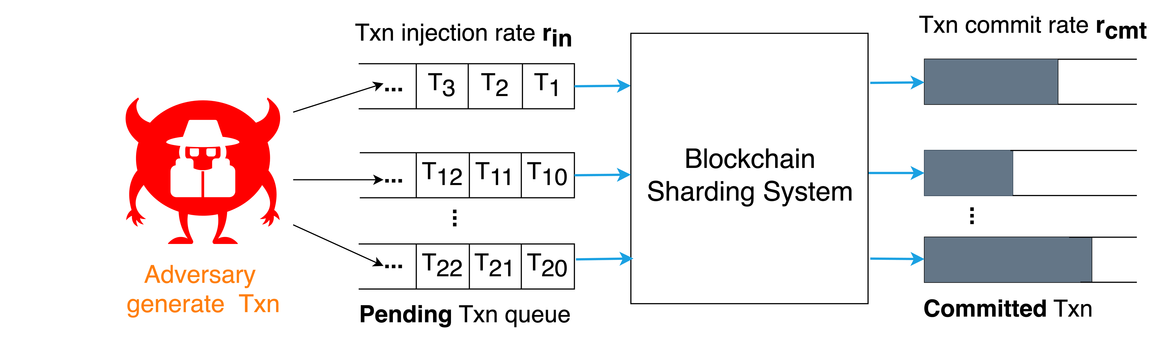
Research Purpose
We aim to make the blockchain sharding system stable under adversarial transaction generation
If r_{cmt} < r_{in} , then system becomes unstable
Notes:
In this work, we aim to make the blockchain sharding system stable under adversarial transaction generation.
Stable in the sense that the number of pending transactions in queues is bounded and the amount of waiting time for each transaction to commit is minimum.
The diagram on the left shows, the adversary generates transactions, with the transaction injection rate, r_{in}​ which are stored in the pending queue of the shards.
The blockchain sharding system needs time to process these transactions. On the right, you see the transaction commit rate, r_{cmt}.
If the transaction commit rate, r_{cmt}​, is less than the transaction injection rate, r_{in}​, the pending queue size grows unboundedly and system becomes unstable. Therefore, it’s important to limit the transaction injection rate.
In this work, we establish an upper bound on the transaction injection rate to keep the system stable.

Slide 5
Background

Slide 6
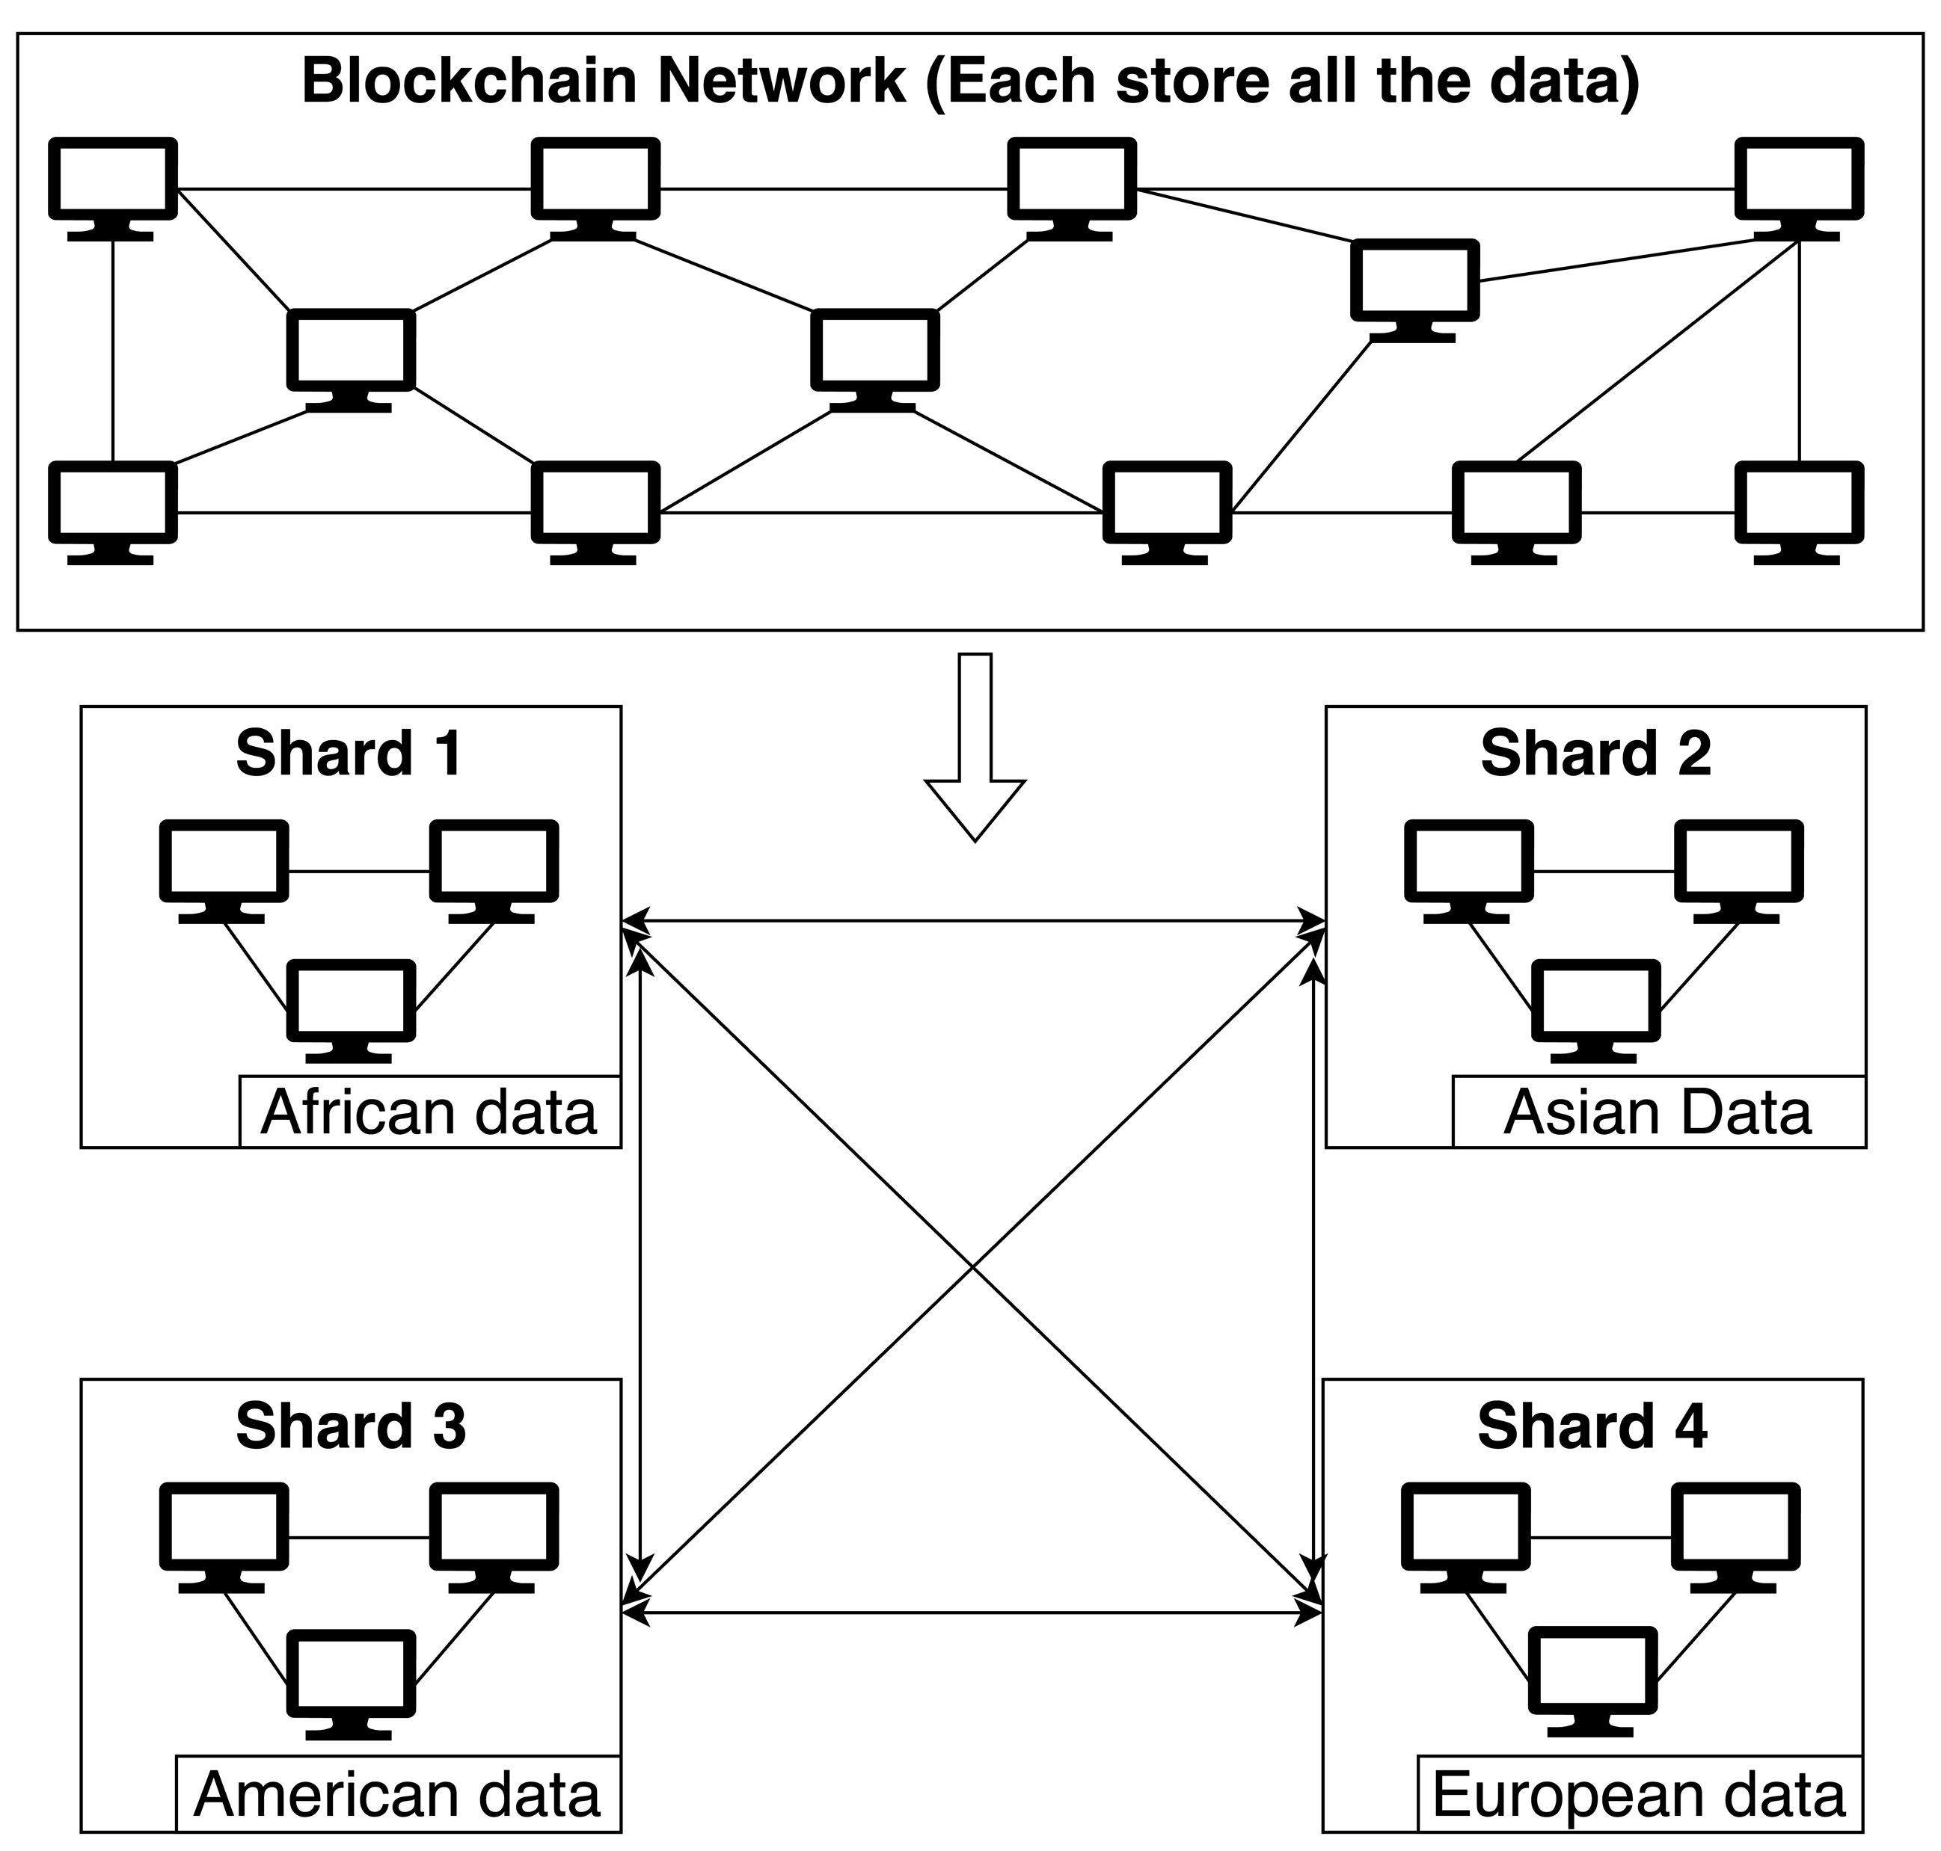
Blockchain Sharding
Blockchain Sharding for Scalability
Divides the blockchain network into smaller groups of nodes called shards
Notes:
Blockchain sharding addresses the scalability issue in blockchain networks by dividing the network into smaller groups of nodes called shards. Each shard processes transactions in parallel to maximize performance.
The top part of the figure illustrates a traditional blockchain network, where each node stores and processes all transactions. The bottom part represents a sharded network which divided network into four geographical regions:
where Shard 1 handles African transactions, Shard 2 handles Asian transactions, Shard 3 processes American transactions, and Shard 4 process European transactions. Shards communicate via message passing for inter-shard transactions.

Slide 7
Blockchain Sharding
Blockchain Sharding for Scalability
Divides the blockchain network into smaller groups of nodes called shards
Each shard processes transactions in parallel
Commit: If they access different accounts
Conflict: If two or more than two transactions try to access same account
Abort: If condition of transaction is invalid
Notes:
Blockchain sharding addresses the scalability issue in blockchain networks by dividing the network into smaller groups of nodes called shards. Each shard processes transactions in parallel to maximize performance.
Transactions are committed if it accesses different accounts.
Transactions conflict when two or more transactions attempt to access the same account, which prevent the transactions to be committed parallelly and forces them to serialize.
Transactions abort if their conditions are invalid, such as insufficient balance or an invalid account address.

Slide 8
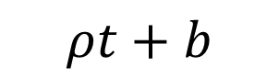
Adversarial Transaction Generation
Transactions are generated continually by an adversary (𝜌, 𝑏)
𝜌 - injection rate per time unit (0 < 𝜌 ≤ 1)
𝑏 – burstiness (0 < 𝑏)
Total number of injected transactions in time interval= 𝜌t + 𝑏
$$ρt+b$$
time
t
Notes:
We assume that the Transactions are generated continually by an adversary characterized by two parameters: 𝜌 and 𝑏. Here, 𝜌 represents the injection rate per time unit (0 < 𝜌 ≤ 1), and 𝑏 denotes the burstiness (0 < 𝑏).
And the total number of injected transactions at time interval is given by: 𝜌t + 𝑏.

Slide 9
Adversarial Transaction Generation
Transactions are generated continually by an adversary (𝜌, 𝑏)
𝜌 - injection rate per time unit (0 < 𝜌 ≤ 1)
𝑏 – burstiness (0 < 𝑏)
Total number of injected transactions in time interval= 𝜌t + 𝑏
Inspired by Adversarial Queueing Theory in networks, where packets are injected continuously
$$ρt+b$$
time
t
Notes:
This adversarial model is inspired by Adversarial Queueing Theory in networks, where packets are injected continuously

Slide 10
Adversarial Transaction Generation
Transactions are generated continually by an adversary (𝜌, 𝑏)
𝜌 - injection rate per time unit (0 < 𝜌 ≤ 1)
𝑏 – burstiness (0 < 𝑏)
Total number of injected transactions in time interval= 𝜌t + 𝑏
Inspired by Adversarial Queueing Theory in networks, where packets are injected continuously
It models security issues (DOS attack) in blockchain sharding system:
The adversary attempts to make the system unstable by injecting too many transactions
$$ρt+b$$
time
t
Notes:
This adversarial model is inspired by Adversarial Queueing Theory in networks, where packets are injected continuously.
It models security issues, such as Denial of Service (DOS) attacks in blockchain sharding systems, where the adversary attempts to make the system unstable by injecting too many transactions.

Slide 11
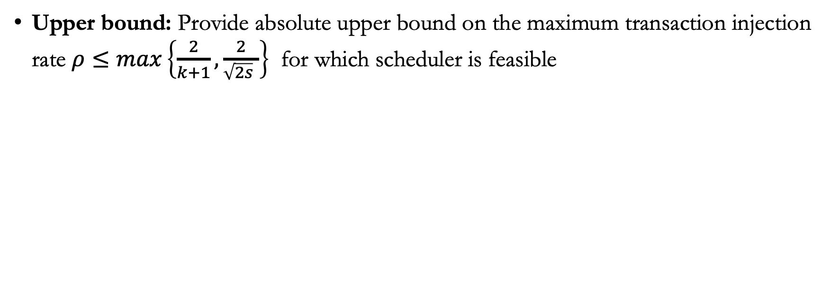
Contributions
Upper bound: Provide absolute upper bound on the maximum transaction injection rate $ρ≤max\left\{\frac{2}{k+1},\frac{2}{\sqrt{2s} }\right\}$ for which scheduler is feasible
s: total number of shards
k: max. no. of shards accessed by each transaction
c: some positive constant
d: worst distance of any transaction to the shards it access
Notes:
We provide the following contributions:
First, we establish the absolute upper bound on the transaction injection rate $ρ≤max\left\{\frac{2}{k+1},\frac{2}{\sqrt{2s} }\right\}$, where s is the total number of shards and k is the maximum number of shards accessed by each transaction.

Slide 12
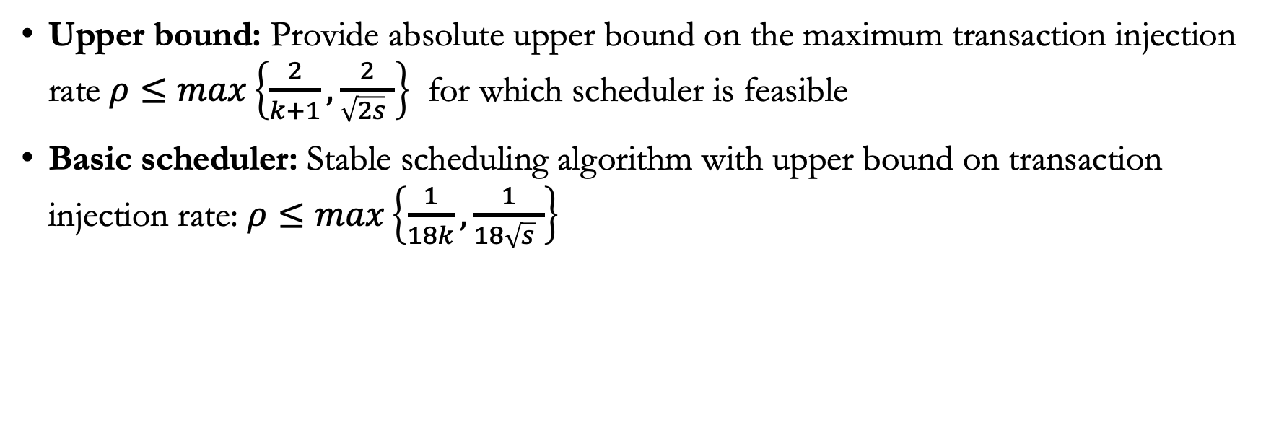
Contributions
Upper bound: Provide absolute upper bound on the maximum transaction injection rate $ρ≤max\left\{\frac{2}{k+1},\frac{2}{\sqrt{2s} }\right\}$ for which scheduler is feasible
Basic scheduler: Stable scheduling algorithm with upper bound on transaction injection rate: $ρ≤max\left\{\frac{1}{18k},\frac{1}{18\sqrt{s} }\right\}$
s: total number of shards
k: max. no. of shards accessed by each transaction
c: some positive constant
d: worst distance of any transaction to the shards it access
Notes:
Next, We provide a basic scheduler to process transaction, and provide the upper bound on the injection rate is $ρ≤max\left\{\frac{1}{18k},\frac{1}{18\sqrt{s} }\right\}$

Slide 13
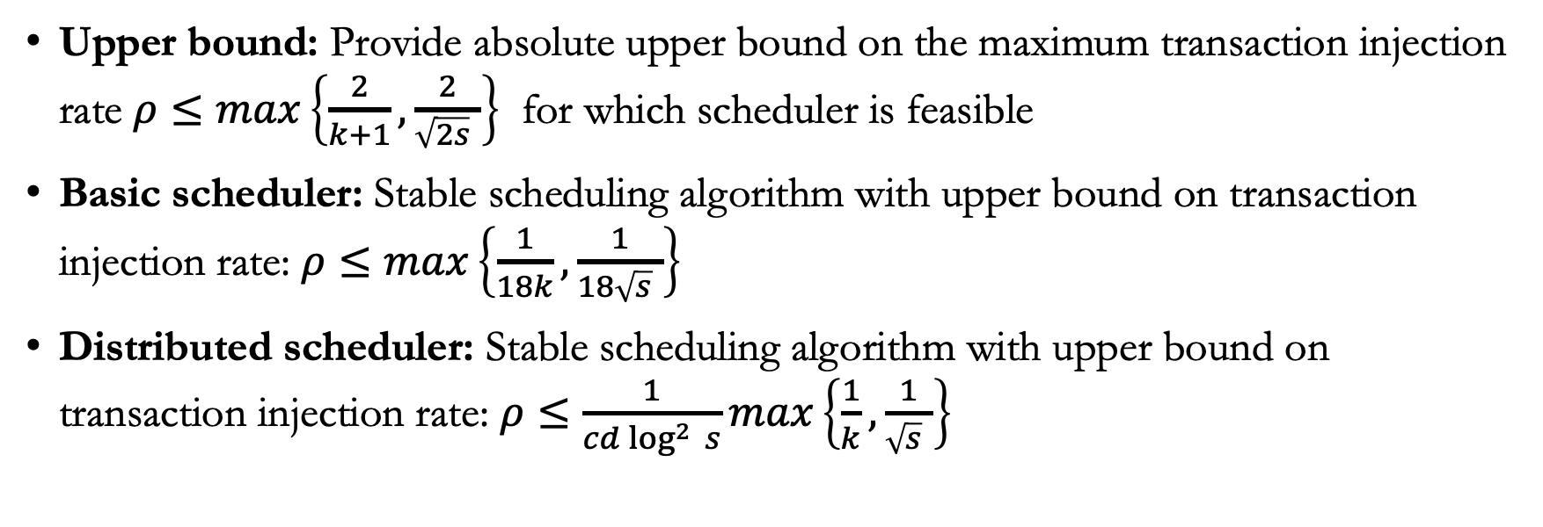
Contributions
Upper bound: Provide absolute upper bound on the maximum transaction injection rate $ρ≤max\left\{\frac{2}{k+1},\frac{2}{\sqrt{2s} }\right\}$ for which scheduler is feasible
Basic scheduler: Stable scheduling algorithm with upper bound on transaction injection rate: $ρ≤max\left\{\frac{1}{18k},\frac{1}{18\sqrt{s} }\right\}$
Distributed scheduler: Stable scheduling algorithm with upper bound on transaction injection rate: $ρ≤\frac{1}{cd\log^{2 }{s}}max\left\{\frac{1}{k},\frac{1}{\sqrt{s} }\right\}$
s: total number of shards
k: max. no. of shards accessed by each transaction
c: some positive constant
d: worst distance of any transaction to the shards it access
Notes:
Next, We provide a distributed scheduler to process transaction, and provide the upper bound on the injection rate is$ρ≤\frac{1}{cd\log^{2 }{s}}max\left\{\frac{1}{k},\frac{1}{\sqrt{s} }\right\}$, where c is a constant and d is the worst distance of any transaction to the shards it access

Slide 14
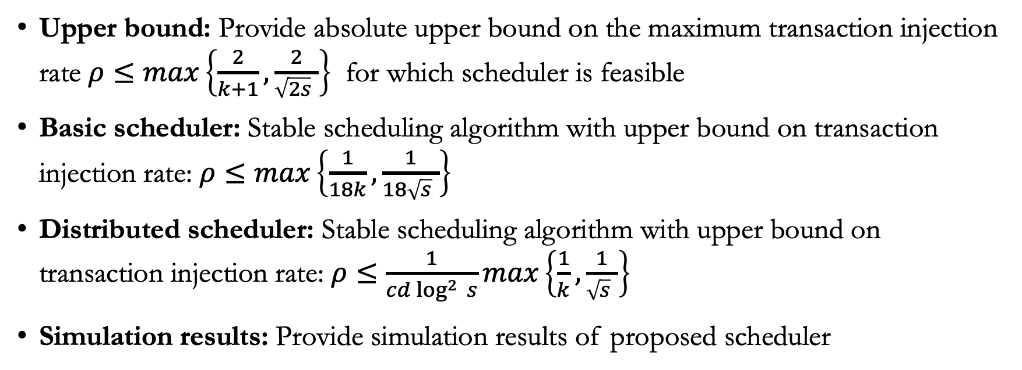
Contributions
Upper bound: Provide absolute upper bound on the maximum transaction injection rate $ρ≤max\left\{\frac{2}{k+1},\frac{2}{\sqrt{2s} }\right\}$ for which scheduler is feasible
Basic scheduler: Stable scheduling algorithm with upper bound on transaction injection rate: $ρ≤max\left\{\frac{1}{18k},\frac{1}{18\sqrt{s} }\right\}$
Distributed scheduler: Stable scheduling algorithm with upper bound on transaction injection rate: $ρ≤\frac{1}{cd\log^{2 }{s}}max\left\{\frac{1}{k},\frac{1}{\sqrt{s} }\right\}$
Simulation results: Provide simulation results of proposed scheduler
s: total number of shards
k: max. no. of shards accessed by each transaction
c: some positive constant
d: worst distance of any transaction to the shards it access
Notes:
Finally, we present simulation results for these schedulers.

Slide 15
Related Works

Slide 16
Related Works
No prior study in the stability analysis of blockchain sharding systems
Prior works in Transactional Memory [1] but cannot directly apply to blockchain sharding
Related works in adversarial queuing[2] provide stability analysis in routing and broadcasting algorithms
[1] Costas Busch, Bogdan S Chlebus, Dariusz R Kowalski, and Pavan Poudel. Stable Scheduling in Transactional Memory. In Algorithms and Complexity: CIAC 2023, 2023
[2] Allan Borodin, Jon Kleinberg, Prabhakar Raghavan, Madhu Sudan, and David P Williamson. Adversarial queuing theory. Journal of the ACM (JACM), 2001
Notes:
In discussing related work, no prior study specifically focusing on the stability analysis of blockchain sharding systems under adversarial transaction generation.
While there are existing works in transactional memory, they cannot be directly applied to blockchain sharding. This is because transactional memory systems typically involve mobile objects and transactions, where transactions immediately execute upon obtaining objects. In contrast, blockchain sharding involves static accounts within shards, with a transaction confirmation mechanism ensuring consistent commitment of transactions in each accessing shard.
Additionally, related works in adversarial queuing have provided stability analysis in routing and broadcasting algorithms.

Slide 17
Our Proposed Models

Slide 18
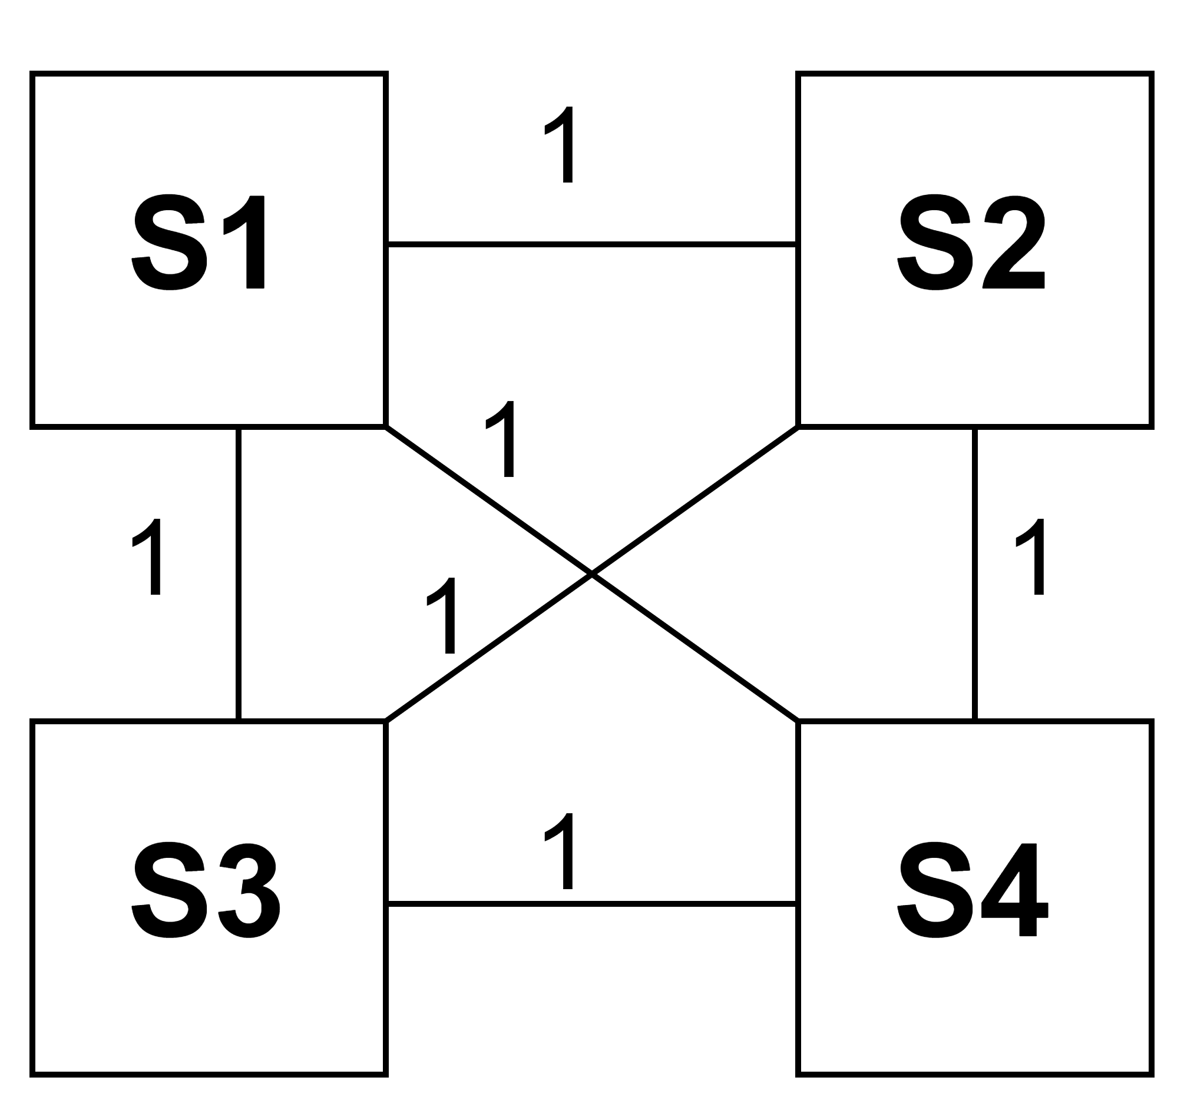
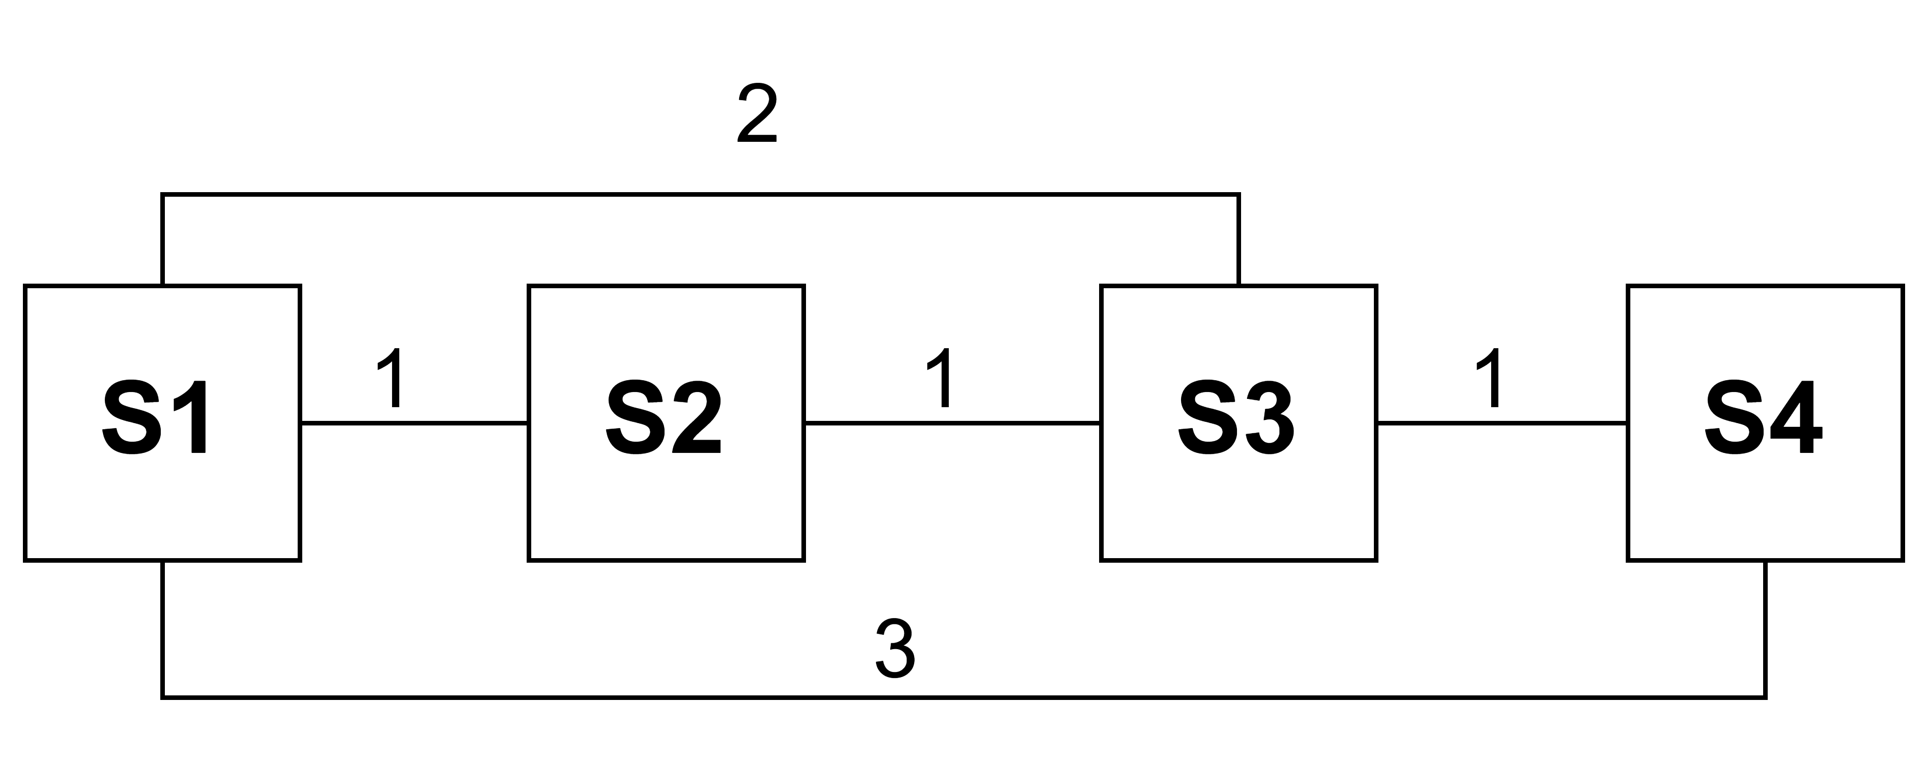
Proposed Models (Schedulers)
Basic Scheduler
Shards are in uniform communication model:
Any two shards are at a unit distance away
Distributed Scheduler
Shards are in non-uniform communication model:
Distance between any two shards ranges from 1 to d,
where d is diameter of shard graph
Notes:
Moving on to our proposed models, we introduce two schedulers designed to process transactions
First, the Basic Scheduler: This model operates under the assumption that shards are in a uniform communication model, meaning any two shards are at a unit distance from each other.
As shown in the top right of the slide, shards are connected in a clique graph with a distance of 1, enabling them to send and receive messages within a single round.
Secondly, the Distributed Scheduler: Here, we consider shards in a non-uniform communication model, where the distance between any two shards can range from 1 to d, with d representing the diameter of the shard graph.
The bottom right figure illustrates this non-uniform communication model.

Slide 19
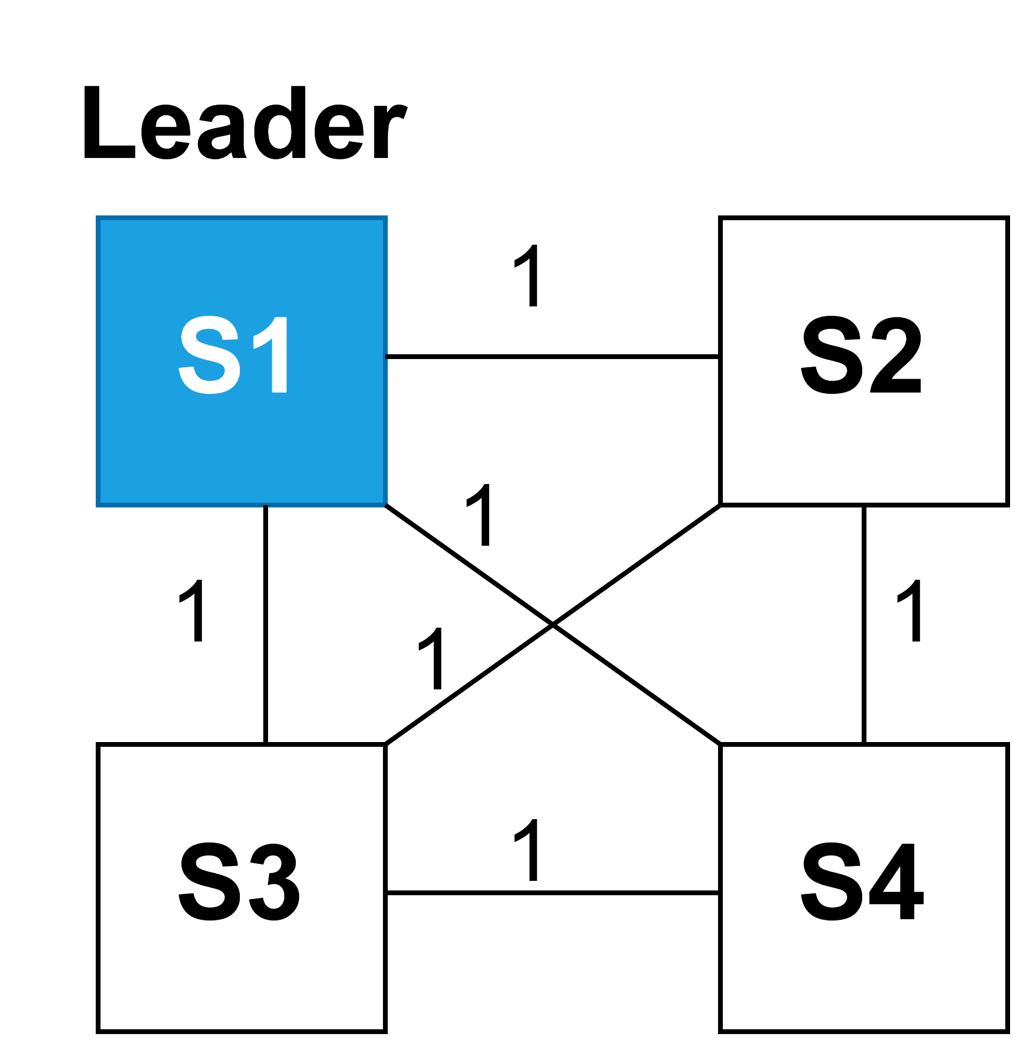
Basic Scheduler
One of the shard is a leader, which determines schedule of transactions by coloring
Notes:
Let’s talk about our proposed Basic Scheduler
Shards are in uniform communication model and we consider one shard as the leader shard, which is responsible for determining the transaction schedule using a greedy coloring approach, as shown in the left figure where Shard S1 is the leader shard.

Slide 20
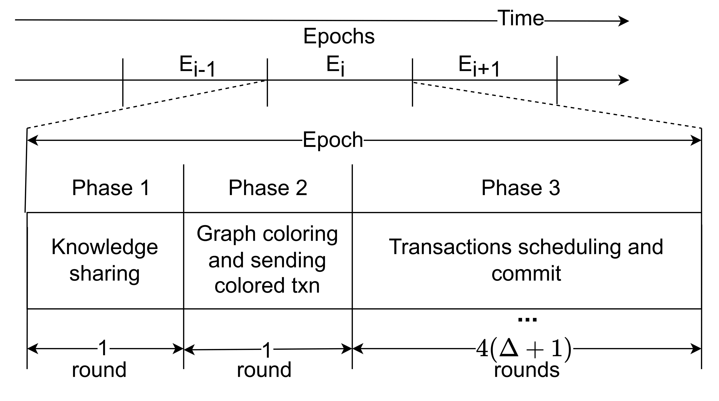
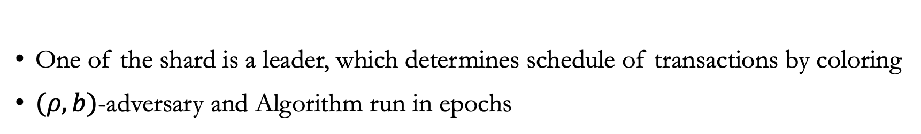
Basic Scheduler
One of the shard is a leader, which determines schedule of transactions by coloring
$(ρ,b)$-adversary and Algorithm run in epochs
Notes:
The adversary (𝜌, 𝑏) generates transactions and distributes them to the shards. The scheduling algorithm operates in epochs with three phases, as depicted on the right
In Phase 1, each shard sends its transaction information to the leader shard.
In Phase 2, the leader shard constructs the conflict graph and colors the transactions using greedy coloring, utilizing at most \Delta+1 colors, where \Delta is the maximum degree of the conflict graph.
In Phase 3, Transactions are committed according to their assigned color. I will describe each phase in detail on the next slide.

Slide 21
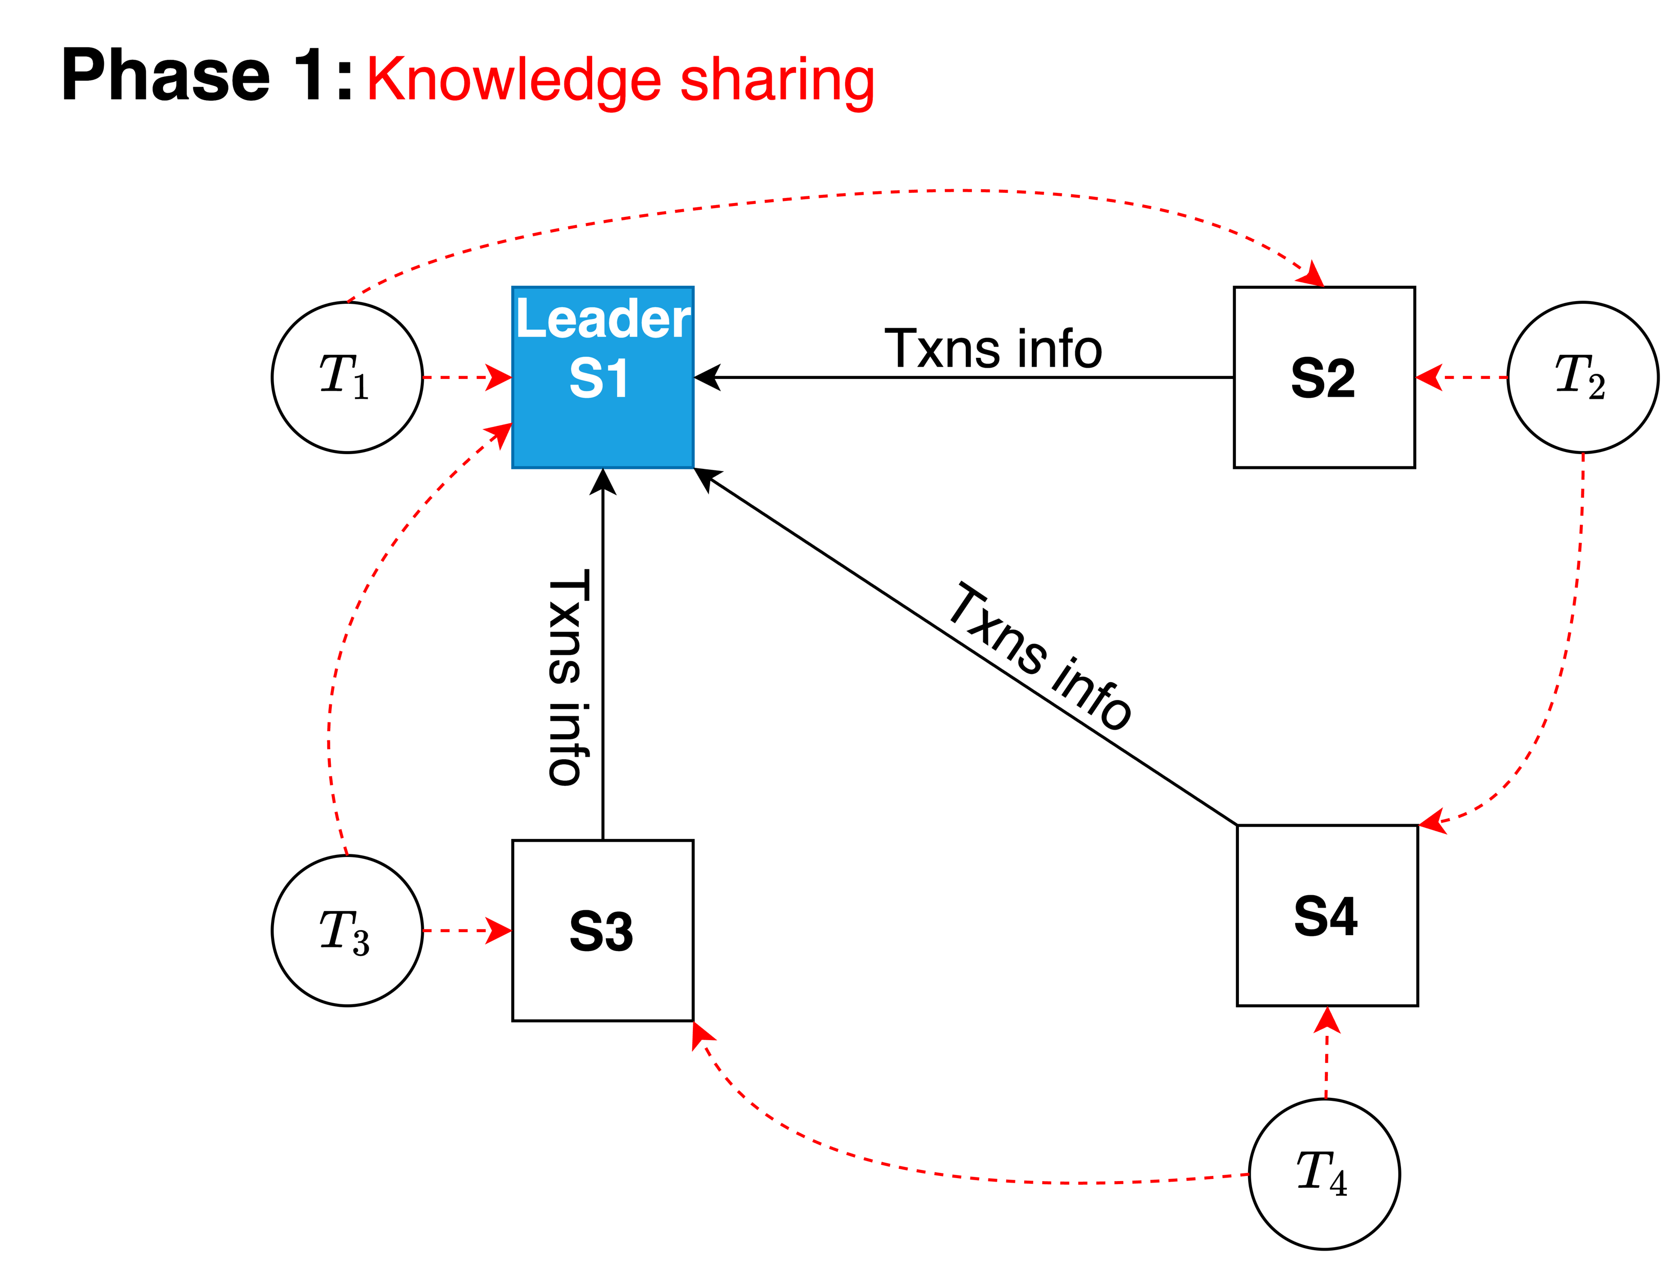
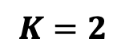
$$K=2$$
Notes:
In Phase 1, each shard sends its transaction information to the leader shard.
Suppose each shard consists of one transaction that needs to be committed, and each transaction accesses at most two shards (k=2).
For example, transaction T1 accesses shards S1 and S2, transaction T2 accesses shards S2 and S4, transaction T3 accesses shards S3 and S1, and transaction T4 accesses shards S4 and S3 as shown by the red dotted arrows. All shard information is sent to the leader shard, which in this example is S1.

Slide 22
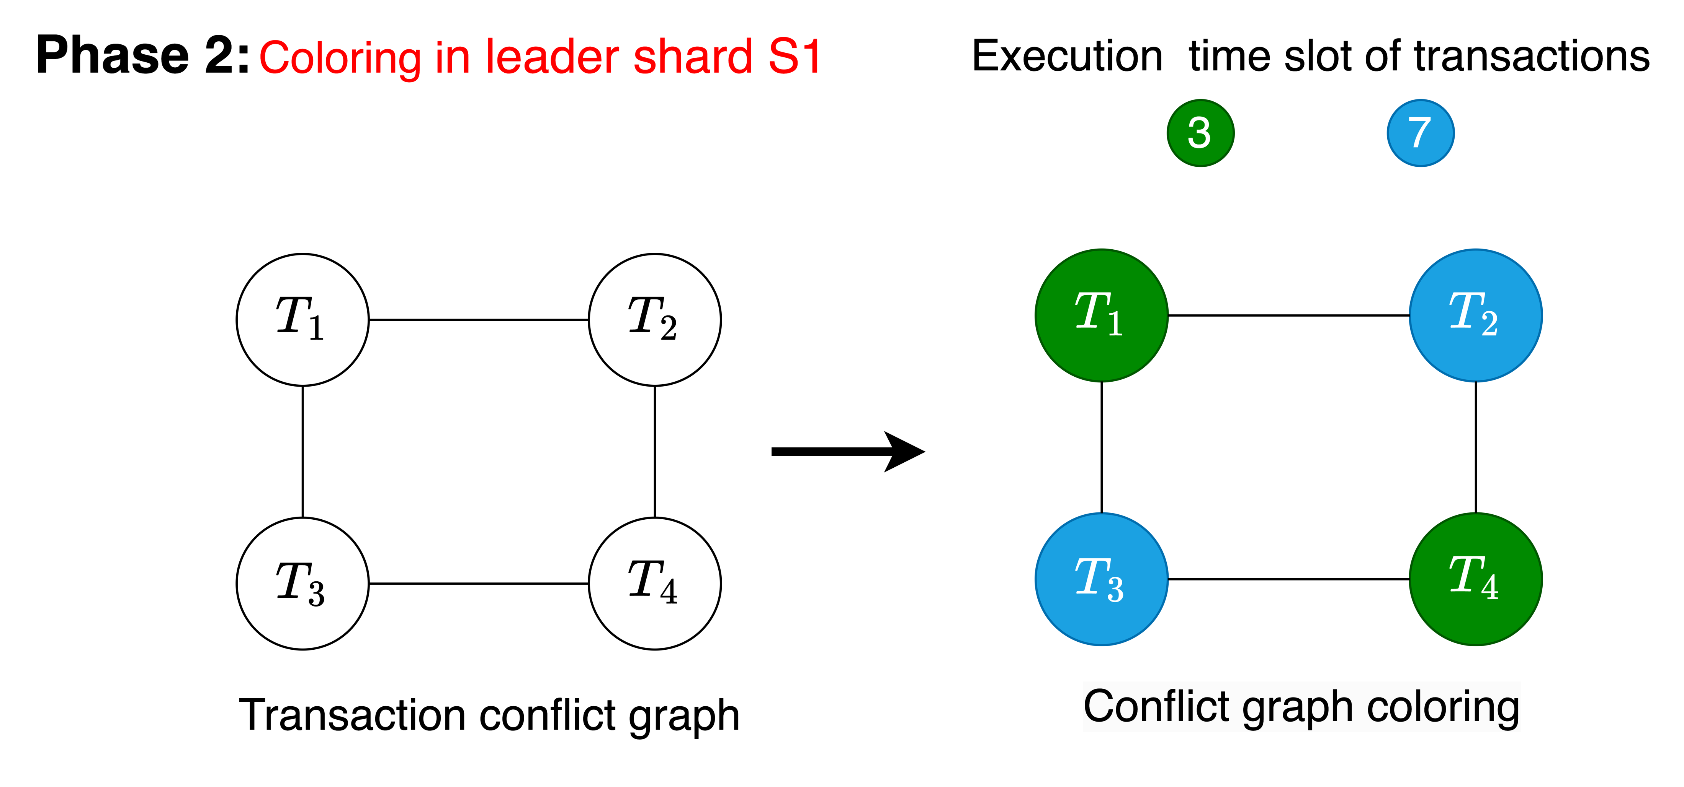
$$K=2$$
Notes:
In Phase 2, the leader shard, S1, constructs a transaction conflict graph and colors the graph using a greedy coloring algorithm, assigning colors to each transaction.
In this example, transactions T1 and T4 both receive the same green color, as they do not conflict and can commit concurrently, while transactions T2 and T3 receive the blue color.

Slide 23
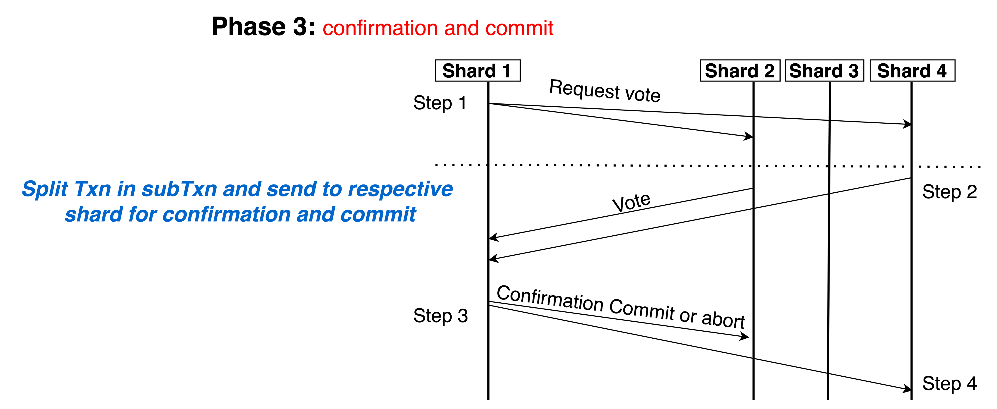
$$K=2$$
Notes:
In the phase 3 each transaction process according to the color they get.
And each Transaction is split into subtransacitons and sent to respective accessing shard for confirmation and commit.
Each color takes a 4-round for confirmation and commit process, shown on the bottom of the slide.
This process is similar to the two-phase commit to ensure consistent transaction commitment in each shard.

Slide 24
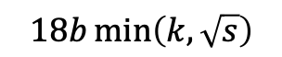
Basic Scheduler
E₁
E₂
E₃
E₄
$$18b\min\left(k, \sqrt{s}\right)$$
Notes:
For the analysis of the Basic Scheduler, we divide time into epochs, where each epoch consists of $18b\min\left(k, \sqrt{s}\right)$ rounds.

Slide 25
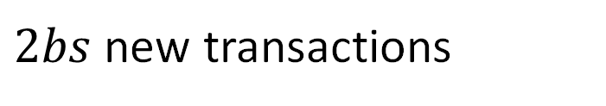
Basic Scheduler
For injection rate $ρ≤max\left\{\frac{1}{18k},\frac{1}{18\sqrt{s} }\right\}$ at most $2bs$ new transactions per epoch
$2bs$ new transactions
E₁
E₂
E₃
E₄
$$18b\min\left(k, \sqrt{s}\right)$$
Notes:
Considering a transaction injection rate of $ρ≤max\left\{\frac{1}{18k},\frac{1}{18\sqrt{s} }\right\}$ , there are at most 2𝑏𝑠 new transactions per epoch.

Slide 26
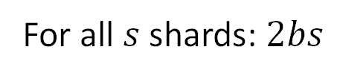
Basic Scheduler
For injection rate $ρ≤max\left\{\frac{1}{18k},\frac{1}{18\sqrt{s} }\right\}$ at most $2bs$ new transactions per epoch
Number of transactions per shard:
$$ρ⋅Epoch length+b≤max\left\{\frac{1}{18k},\frac{1}{18\sqrt{s} }\right\}⋅18b\min\left(k, \sqrt{s}\right)+b≤b+b=2b$$
For all $s$ shards: $2bs$
$2bs$ new transactions
E₁
E₂
E₃
E₄
$$18b\min\left(k, \sqrt{s}\right)$$
Notes:
This is because the number of transactions per shard is bounded by the maximum transaction injection rate multiplied by the epoch length plus b, resulting in at most 2𝑏 new transactions per shard.
If we consider for all s shards, this gives us at most 2𝑏𝑠 transactions per epoch.

Slide 27
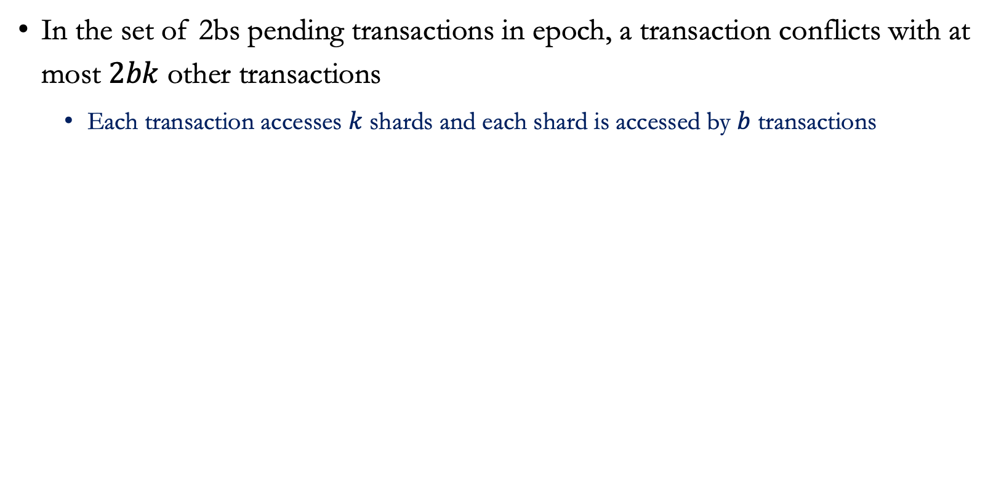
Basic Scheduler
In the set of 2bs pending transactions in epoch, a transaction conflicts with at most $2bk$ other transactions
Each transaction accesses $k$ shards and each shard is accessed by $b$ transactions
Notes:
In the set 2𝑏𝑠 pending transactions in each, a transaction conflicts with at most 2𝑏𝑘 other transactions. This occurs because each transaction accesses 𝑘 shards, and each shard is accessed by 𝑏 transactions

Slide 28
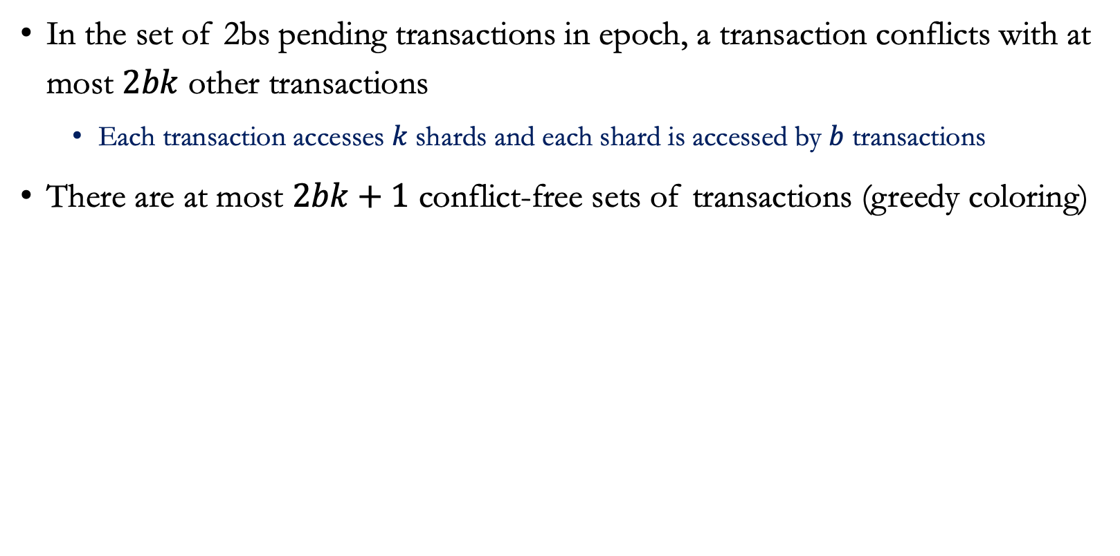
Basic Scheduler
In the set of 2bs pending transactions in epoch, a transaction conflicts with at most $2bk$ other transactions
Each transaction accesses $k$ shards and each shard is accessed by $b$ transactions
There are at most $2bk+1$ conflict-free sets of transactions (greedy coloring)
Notes:
With this constraint, there are at most 2𝑏𝑘+1 conflict-free sets of transactions, determined by a greedy coloring approach.

Slide 29
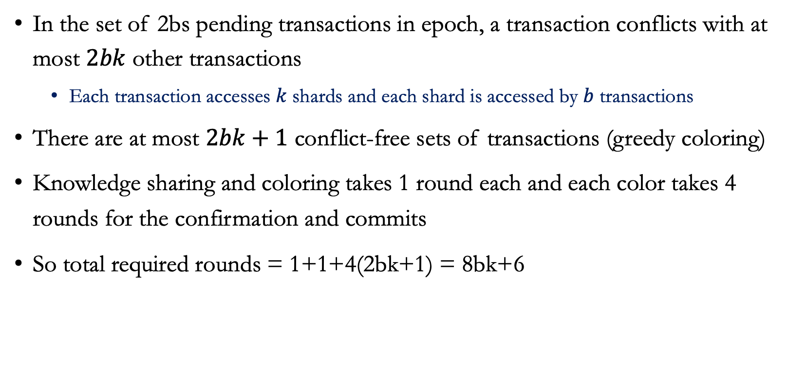
Basic Scheduler
In the set of 2bs pending transactions in epoch, a transaction conflicts with at most $2bk$ other transactions
Each transaction accesses $k$ shards and each shard is accessed by $b$ transactions
There are at most $2bk+1$ conflict-free sets of transactions (greedy coloring)
Knowledge sharing and coloring takes 1 round each and each color takes 4 rounds for the confirmation and commits
So total required rounds = 1+1+4(2bk+1) = 8bk+6
Notes:
Knowledge sharding and coloring on leader shard each takes 1 rounds
Moreover, Each color takes 4 rounds for confirmation and commit, totaling 1+1+4(2𝑏𝑘+1) = 8𝑏𝑘+6 rounds.

Slide 30

Basic Scheduler
In the set of 2bs pending transactions in epoch, a transaction conflicts with at most $2bk$ other transactions
Each transaction accesses $k$ shards and each shard is accessed by $b$ transactions
There are at most $2bk+1$ conflict-free sets of transactions (greedy coloring)
Knowledge sharing and coloring each takes 1 round and each color takes 4 rounds for the confirmation and commits
So total required rounds = 1+1+4(2bk+1) = 8bk+6
We consider epoch length is at most $18 b k>8bk+6$which is sufficient to process all transactions
Notes:
We consider epoch length is at most $18 b k>8bk+6$which is sufficient to process all transactions

Slide 31
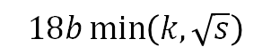
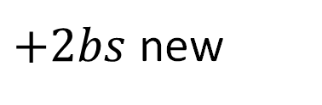
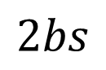
Basic Scheduler
Transactions generated in an epoch execute by the end of next epoch
$$2bs$$
$+2bs$ new
E₁
E₂
E₃
E₄
$$18b\min\left(k, \sqrt{s}\right)$$
Hence, at most $4bs$ pending transactions per epoch
Stability!
Notes:
So the transactions generated in an epoch execute by the end of the next epoch, and there will be new 2𝑏𝑠 transactions in each epoch. Hence, there are at most 4𝑏𝑠 pending transactions per epoch. Thus, the system is stable.

Slide 32
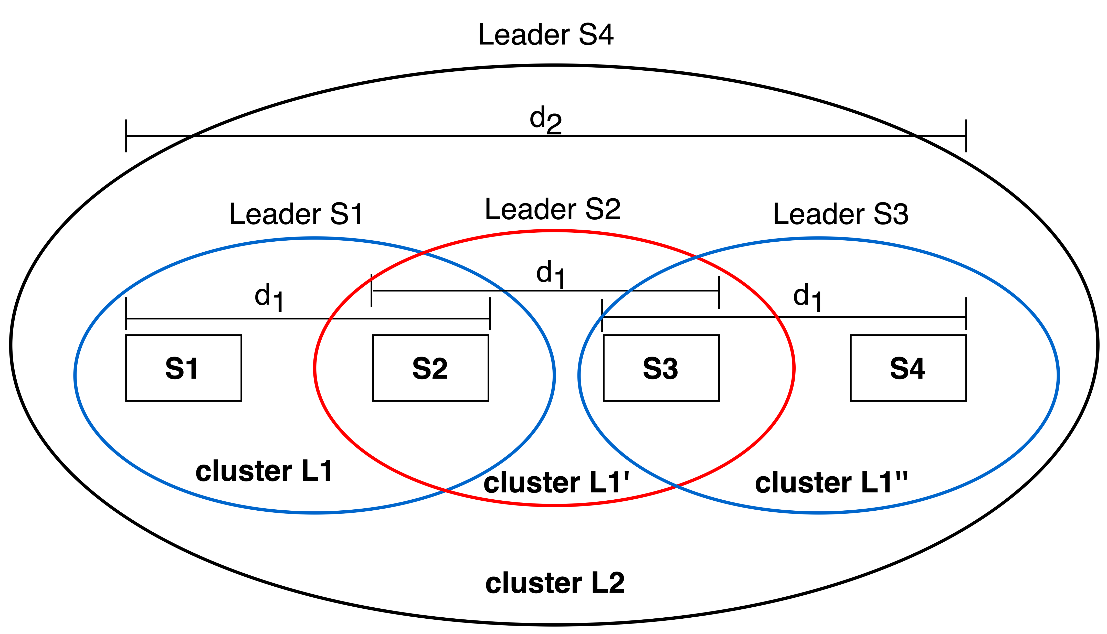
Distributed Scheduler
Algorithm uses hierarchical clustering of the shards
Each cluster has its own leader which colors and determines the schedule of transactions of that cluster
Each transaction finds their cluster according to the distance between transaction and accessing shards
Similar approach as in Basic scheduler in each cluster. However, conflict-free sets are discovered in a distributed manner
Notes:
In the distributed scheduler, shards are arbitrarily far from each other. The scheduling algorithm use a hierarchical clustering of the shard graph, which is calculated before the algorithm starts and is known to all shards.
Clusters are formed based on the distance between shards, as shown in the figure.
Each cluster has one designated leader, responsible for determining the schedule for transactions of that cluster. For a instance, Cluster L1 has Leader S1 which process transactions of that cluster.
Each Transactions find their cluster based on the distance between the transaction and the accessing shards. Each cluster operates similarly to the Basic Scheduler, where leader of that cluster colors the transactions and determine the schedule. However, Conflict-free sets are discovered in a distributed manner

Slide 33
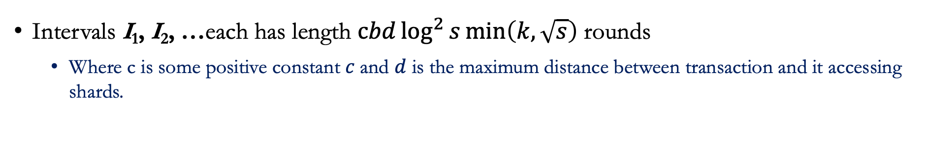
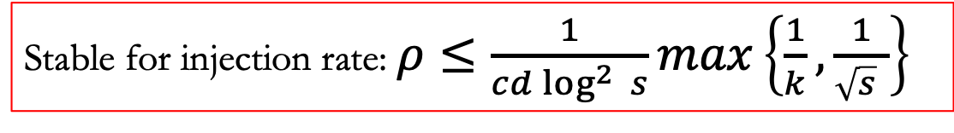
Distributed Scheduler
Intervals I₁, I₂, …each has length $cbd\log^{2}{s}\min\left(k, \sqrt{s}\right)$ rounds
Where c is some positive constant $c$and $d$ is the maximum distance between transaction and it accessing shards.
Stable for injection rate: $ρ≤\frac{1}{cd\log^{2 }{s}}max\left\{\frac{1}{k},\frac{1}{\sqrt{s} }\right\}$
We show:
For injection rate $ρ≤\frac{1}{cd\log^{2 }{s}}max\left\{\frac{1}{k},\frac{1}{\sqrt{s} }\right\}$ at most $4bs$ pending transactions per interval
Stability!
Notes:
For the analysis of distributed scheduler, we divide time into intervals, each with a length of $cbd\log^{2}{s}\min\left(k, \sqrt{s}\right)$ , where c is a positive constant and 𝑑 is the maximum distance between a transaction and its accessing shards. These intervals are composed of epochs.
We show that for an injection rate $ρ≤\frac{1}{cd\log^{2 }{s}}max\left\{\frac{1}{k},\frac{1}{\sqrt{s} }\right\}$, there are at most 4𝑏𝑠 pending transactions per interval and system remains stable.

Slide 34
Simulation Results

Slide 35
Simulation Results
Simulated using python, in MacBook Pro 10-core, 32 GB RAM
Total number of shards (s)=64
Number of accounts = 64 (one account per shard)
Max. no. of shards accessed by each transaction (k) = 8
Notes:
We simulated our proposed algorithm using the Python programming language on a MacBook Pro with a 10-core processor and 32 GB of RAM.
Our simulation settings included a total of 64 shards, with one account per shard. Additionally, we set the maximum number of shards accessed by each transaction to 8.

Slide 36
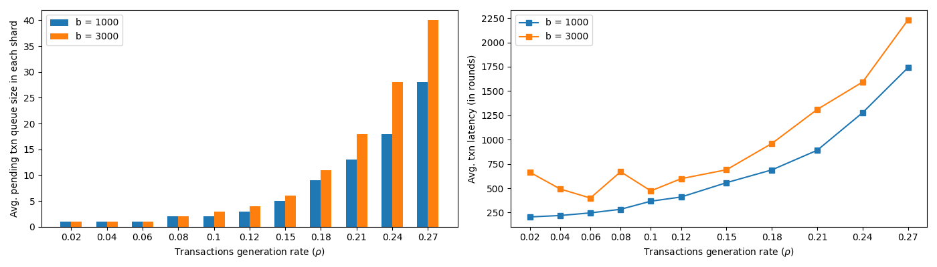
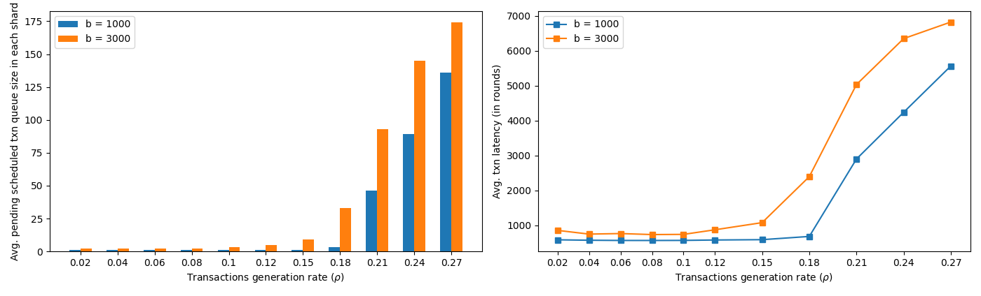
Simulation Results
Basic Scheduler
Distributed Scheduler
On the left, the average pending transactions in the queue of each shard is shown versus 𝜌. On the right, the average transaction latency measured in rounds is plotted against 𝜌.
Notes:
The figure shows the simulation results, with the top chart showing the results for the basic scheduler and the bottom chart showing for the distributed scheduler.
In each chart, the left bar graph shows the average pending transaction queue size versus the transaction injection rate 𝜌. The right line graph represents the average transaction latency with respect to the transaction injection rate 𝜌.
The results indicate that the queue size remained stable until 𝜌 reached to about 0.15. Beyond this point, the queue size and transaction latency grew exponentially.
Thus it is important to limit the transaction injection rate to maintain system stability. This validate our theoretical result.

Slide 37
Conclusion and Future Work

Slide 38
Conclusions and future work
Studied blockchain sharding system with adversarial transaction generation:
Designed Basic Scheduler and Distributed Scheduler and provide upper bound on transaction injection rate
Implication
Blockchain designers can use our results to design stable blockchain system, which is resilient to Denial of Service Attack (DOS)
Future work:
Exploring efficient communication mechanism between shards with minimum message size
Exploring the systems with heavy traffic
Notes:
In conclusion, we have studied the blockchain sharding system under adversarial transaction generation
We design the basic and distributed scheduler and provide the upper bound on transaction injection rate to keep system stable.
We also provide the simulation results of proposed scheduler
Implication of our research is Blockchain designers can use our findings to design stable blockchain systems that are resilient to Denial of Service (DOS) attacks.
For future work, we intend to explore efficient communication mechanisms between shards with a focus on minimizing message size.
We also want to explore the effect on systems with heavy traffic, as our results not only prevent DoS but generally try to make stable systems with high generation rate

Slide 39
Thank You!
Questions?

